Slide 1
An Overview of RTCA DO-178B
Scott Messner
March 4th, 2007
Notes:
Alrighty, this is my presentation of the DO-178 certification standard.

Slide 2
What is DO-178B?
Titled “Software Considerations in Airborne Systems and Equipment Certification”.
It’s European equivalent is ED-12B.
A document that addresses the life process of developing embedded software in aircraft systems.
It is a commonly accepted standard worldwide for regulating safety in the integration of software in aircraft systems.
Notes:
The technical title doesn’t say much. It’s formal title is “Software considerations in Airborne Systems and Equipment Certification”.
ED-12B is it’s identical twin – I’ll explain more about that later.
The purpose of the document is to provide a standard for software development in aircraft systems.
Before an aircraft system can be deployed it must pass an “airworthiness” certification held by regulatory organizations such as the (Federal Aviation Administration) or (European Aviation Safety Agency).
And DO-178B is acknowledged as the standard means for the certification of software portion of an avionics system.

Slide 3
History of DO-178B
Software in avionics has been around since the 1970’s
By adding software to a system, certification becomes more complex.
The RTCA creates DO-178 in 1980, while EUROCEA works on ED-35.
The merged result is DO-178 / ED-12: the first common certification criteria for production of avionics software.
Notes:
Software was first introduced to aircraft systems in the 70’s.
Companies found it was much easier and less costly to replace what used to be hardware components with software that could mimic the same functionality.
By doing this, certification becomes a bit more tricky: Now the system is subject to potential design flaws in both hardware and software.
The Radio Technical Commission for Aeronautics begins producing DO-178. About the same time the European Organisation for Civil Aviation Equipment makes an equivalent ED-35.
Both groups merged their ideas to produce a common certification criteria that resulted in the paralleled creation of DO-178 and ED-12.

Slide 4
Evolution of DO-178B
In 1985, revisions and updates were made to produce DO-178A / ED-12A.
The documents became a worldwide basis for software certification in the aviation industry.
DO-178B / ED-12B started in 1989 and finalized in 1992.
Notes:
In 1985, the original document was updated and revised – leading to DO-178A and ED-12A (Again, identical content).
It shortly after became a worldwide accepted standard for certification of avionics software.
In 1989, RTCA and EUROCEA began the next revision, which was to make the switch from “module” testing to requirements based testing.
The final draft of DO-178B and ED-12B was released in 1992.
DO-178B is the currently used document by FAA, EASA, and elsewhere.

Slide 5
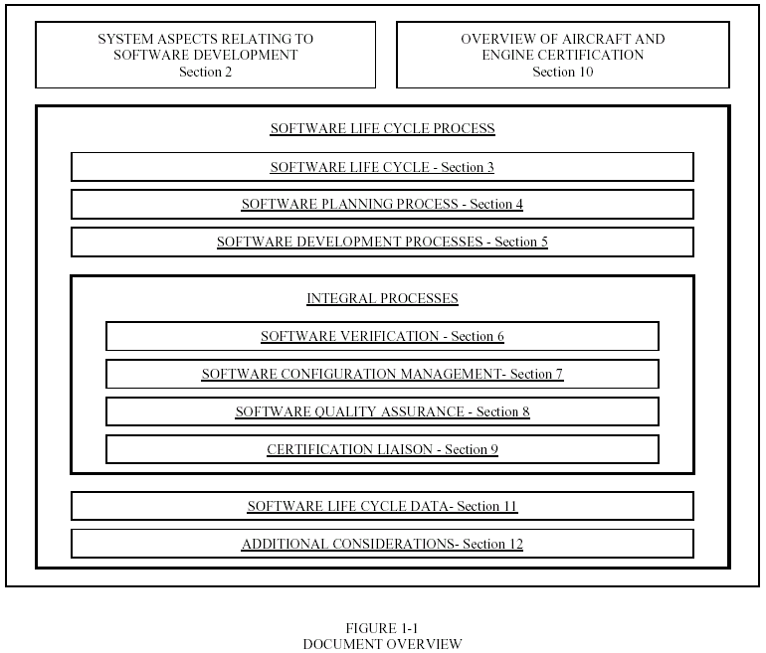
DO-178B Document Layout
Figure 1-1 Taken from AVISTA’s “DO-178B Presentation”
Notes:
This is the general structure of the document.
So, up top, we have Section 2 which addresses the portions of the system that will pertain to software development.
And Section 10 which provides an overview of aircraft and engine certification within scope of the entire system (not just the software).
The remaining sections are steps in certification of the entire process of the Software Life Cycle.

Slide 6
DO-178B Software Levels
DO-178B requires that all system requirements be mapped to one of the five software levels.
Level A - most critical failure level. Failure at Level A results in catastrophic failure conditions for an aircraft.
Level B - the software at this level contributes to severe-major failure conditions.
Level C - software at this level contributes to major failure conditions.
Level D - software at this level contributes to minor failure conditions.
Level E - the software has no effect toward potential failure conditions.
Notes:
DO-178B forces all software requirements be mapped to a software level that describes the level of criticality the software functions at during possible failure conditions.
Any requirement mapping to a level other than Level E is suspect to the further certification using DO-178B
So obviously, requirements mapped with higher levels need more rigorous planning, coding, and testing. They also require more secure configuration management and are suspect to higher levels of quality assurance.
The software levels of DO-178B are a very crucial aspect for producing certified product safety.

Slide 7
DO-178B Processes and Outputs
DO-178B is divided into five main processes:
Software Planning
Software Development
Software Verification
Software Configuration Management
Software Quality Assurance
Each process has a set of expected documented outputs.
Notes:
DO-178B divides the Software Life Cycle Process into five main processes. Software Planning, Development, Verification, Configuration Management, and Quality Assurance.
At each process level, there are a number of documents that must be produced before advancing to the next process.
Let’s take a look at some of the outputs.

Slide 8
Software Planning Process
Purpose is to determine what will be done to produce safe, requirements-based software.
Expected outputs:
Plan for Software Aspects of Certification (PSAC)
Software Development Plan
Software Verification Plan
Software Configuration Management Plan
Software Quality Assurance Plan
Notes:
The planning process is where all the plans are made. We have gathered system-level requirements and we want to calculate an approach towards effectively and safely satisfying the requirements.
The PSAC provides details on product requirements and how the supplier intends to meet these requirements.
The Software Development Plan is meant to define the software life-cycle and the development environment.
The Software Verification Plan is the proposed method of verification that will satisfy all objectives of the software verification process.
The Software Configuration Plan is similarly the proposed method of configuration management.
The Software Quality Assurance Plan is the proposed plan for satisfying the objectives of the software quality assurance process.
So again these documents are intended to outline what will be done to achieve the objectives of the following processes.

Slide 9
Software Development Process
The software development process is broken into four sub-processes:
Software Requirements Process
High-level requirements in relation to function, performance, interface and safety.
Software Design Process
Low-level requirements used to implement the source code.
Software Coding Process
Production of source-code from the design process.
Integration Process
Integration of code into a real-time environment.
Notes:
The software development process is broken into pieces:
The objectives of the Software Requirements sub-process is to develop high-level software requirements that have been assessed according to the safety assessment process.
The purpose of Software Design Process is to break down high-level requirements into design-level requirements that can traced directly from code.
The Software Coding Process begins when the low-level requirements are turned into code. Note that the code must be traceable to the requirements from the design process.
Finally the integration process is what takes the code and integrates it into it’s real-time environment along with hardware components.

Slide 10
Software Development Process Continued…
The following tangible outputs are the result of the combined four sub-processes:
Software requirements data (SRD)
Software design description (SDD)
Source code
Executable object code
Notes:
So again, each process has expected outputs.
By the end of the Software Development Process you should have the following:
A Software Requirements Data document.
A Software Design Description or architecture diagram
The implemented source code
And the executable object within its real-time environment.

Slide 11
Software Verification Process
The purpose is to identify and report any errors resulting from the development process.
The verification process objectives can be met with reviews, walkthroughs, unit testing, integration testing, and more.
Proof of objectives is within the execution of the testing procedures.
Outputs include:
Software Verification Cases and Procedures
Software Verification Results
Notes:
The software verification process is the testing area. The hope is to detect any possible errors that were introduced during the development process.
So The objective is to show proof of adequate testing and traceability of all code to its corresponding requirements.
This is done using a combination of reviews, walkthroughs, and multiple types of test documents.
The verification process is not complete until it is proven that all tests have passed.
Then the formal expected outputs for the verification process are the SVCP and the SVR (which contains a review of the requirements, design and code, tests in its intended environment, and strict code coverage analysis)

Slide 12
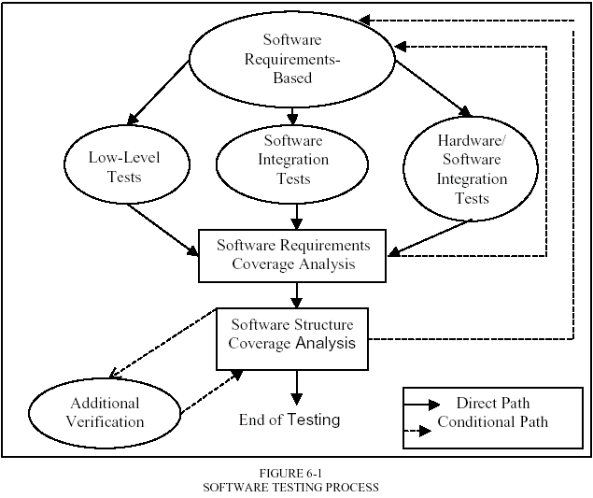
Software Verification Process Continued…
Figure 6-1 Taken from AVISTA’s “DO-178B Presentation”
Notes:
This is a diagram of the Software Testing Process.
There’s low-level tests
As well as Integration tests for the software components
And Integration tests for software with hardware.
Each of these is reviewed against coverage analysis until full coverage of software requirements is met
Then coverage analysis of the code is done and any other verification.
Note:
The verification process for software is very defined in DO-178B and could honestly be covered in it’s own presentation…

Slide 13
Software Configuration Management Process
The purpose is to establish secure and effective configuration control for all artifacts.
The following activities are done within the process:
Configuration Identification
Change Control
Baseline establishment
Archiving of the software
Outputs include: Software Configuration Index, and Software Life Cycle Environment Configuration Index.
Notes:
The purpose is to establish secure and effective configuration control for all artifacts produced throughout the software life-cycle.
There are four activities that are completed within the CM process:
First off, all artifacts within configuration control must have a means for being uniquely identified and referenced.
Next controlled items must have an established method of change. Changes need to traceable and reversible.
A baseline, or point of origin, must be defined for each item under configuration control.
Archiving of the software provides an extra portion of security and change control.

Slide 14
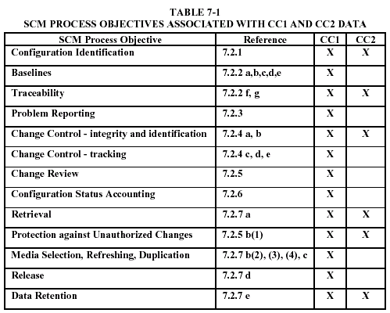
Software Configuration Management Process (Continued…)
Figure 7-1 Taken from AVISTA’s “DO-178B Presentation”
Notes:
This slide shows an association between software levels and CM. I haven’t mentioned the two control categories yet…
They represent the level of strictness that is held when dealing with controlled software items.
Items that contain data pertaining to higher software levels such as Level A, are assigned under CC1.
Then the table shows what must be done for items each in CC1 and CC2.

Slide 15
Software Quality Assurance Process
The purpose is to provide assurance that the software life cycle process is going to yield quality software.
Each process is analyzed to show that each process is producing the expected outputs.
Any changes from originally proposed plans are reported, evaluated, and resolved to ensure process integrity.
Notes:
The goal of the Quality Assurance Process is to prove that the software life cycle process is going to, has, and will continue to yield a software product that meets the certification criteria.
This is done by reviewing the transitions between processes to see if the produced inputs and outputs match the expected.
Also, because changes to the plan are inevitable, these changes must be tracked and reviewed to make sure the integrity of the process is not thwarted.

Slide 16
DO-178B Processes: Review
DO-178B software life-cycle process is divided into five main processes:
Software Planning
Software Development
Software Verification
Software Configuration Management
Software Quality Assurance
The objective-based approach of DO-178B makes it flexible to individual projects.
Notes:
So that covers the software life-cycle process through planning, development, verification, CM, and quality assurance.
This is an important feature to the document because it makes it very easy for companies to define for themselves how they plan to produce the expected outputs.

Slide 17
DO-178B Certification
D0-178B very specifically addresses the following which directly affects product development.
Certification of a product applies only to it's finished result.
Certification includes approval of all systems and subsystems, hardware, software, firmware, development tools, production, and testing of the product.
Certification is done on the individual application of the product
Coding practices must be certified to ensure things like "dead code" are not allowed.
Certification requires that 'full testing' of the system and all of it's components (including firmware) be done on the target platform in the target environment.
Certification requires code testing at the MCDC level.
Notes:
Assuming the processes have been followed I wanted to mention some other important things about DO-178B certification.
Certification of a product applies only to it's finished result.
Certification includes approval of all systems and subsystems, hardware, software, firmware, development tools, production, and testing of the product.
Certification is done on the individual application of the product. (other applications of the same product must be individually certified)
Coding practices must be certified to ensure things like "dead code" are not allowed. Also all code must be traceable to the design requirements.
Certification requires that 'full testing' of the system and all of it's components (including firmware) be done on the target platform in the target environment (tests that simulate the platform or environment are not enough).
Certification requires code testing at the MCDC level

Slide 18
The Future of DO-178C
The evolution of avionics software has forced a change upon the certification process.
DO-178B was written absently in mind of older software tools.
Advanced technologies and the growing complexities of newer avionics software needs to be addressed.
Notes:
DO-178B has been a provided a solid software standard for over 15 years in the avionics industry,
but changes in technology and the introduction of new software development methods has forced for a renewal of the certification guidelines.

Slide 19
The Future of DO-178C
A committee has formed on behalf of the two major contributors (RTCA and EUROCAE) to produce DO-178C / ED-12C.
Work has been started as of March 2005 and looks to be finished and published in December 2008.
The document looks to tackle the introduction of new software development techniques among other things.
I’m sure we’re all looking forward to it.
Notes:
The proposal for the revision and creation of DO-178C has led to the gathering of a committee of over 200 people across 7 subgroups.
Apparently the committee has already started working on and looks to be finished with it in 2008. I believe that includes replacement of DO-178B.
The introduction of new software development techniques such as object-oriented programming and model based development.
Also: The impact of the new DO-178C could potentially force changes to DO-178B-compliant software (that includes development tools), but the committee is designing the document with that in consideration.
And… That’s all we got.

Slide 20
References and Works Cited
Avista Incorporated®, “DO-178B Basic Overview.” 7 July 2004. PowerPoint Presentation.
“CDA Aerospace DO178B.” cdaservices.com. 2004. CDA Design Group. 29 April 2006. http://www.cdaservices.com/do178bapproval.htm.
“SCOOP in English.” embeddedtouch.com. 2005. EmbeddedTouch. 4 March 2007. http://www.embeddedtouch.com/et/client/050503841118.php?lg=en.
“DO-178B, Software Considerations in Airborne Systems and Equipment Certification.” Wikipedia The Free Encyclopedia. 4 Mar. 2007. Wikimedia Foundation, Inc. June 2003. http://en.wikipedia.org/wiki/DO-178B.
Johnson, Leslie A. (Schad). DO-178B, “Software Considerations in Airborne Systems and Equipment Certification.” Flight Systems. 4 March 2007. Boeing Commercial Airplane Group. 4 March 2007. http://www.stsc.hill.af.mil/crosstalk/1998/10/schad.asp.
Gasperoni, Franco. “Safety, Security, and Object-Oriented Programming.” Computer Science, at the University of Virginia. 29 October 2006. http://www.studyguide.org/MLAdocumentation.htm.
Carol Taylor, Jim Alves-Foss, and Bob Rinker. “Executive Summary Towards Common Criteria Certification for DO-178B Compliant Airborne Software Systems.” Center for Secure and Dependable Systems, University of Idaho. 25 Feb. 2002. http://www.csds.uidaho.edu/comparison/execsumm.pdf.

